Slide 1

Memorial University of Newfoundland
COMP-6999 Master’s Project
Department of Computer Science
Real-Time Data Streaming Visualization And Control Interface
Presented By
Neha Thakare (202287127)
Supervised By
Dr. Edward Brown
Date: 02/08/2024

Slide 2
Table of Content
Introduction
Background and Motivation
Literature Review
Methodology
Architecture Structure
Data Collection and Processing
Visualization Framework
Control Interface
Results and Findings
Challenges and Solutions
Future Work
Conclusion
2

Slide 3
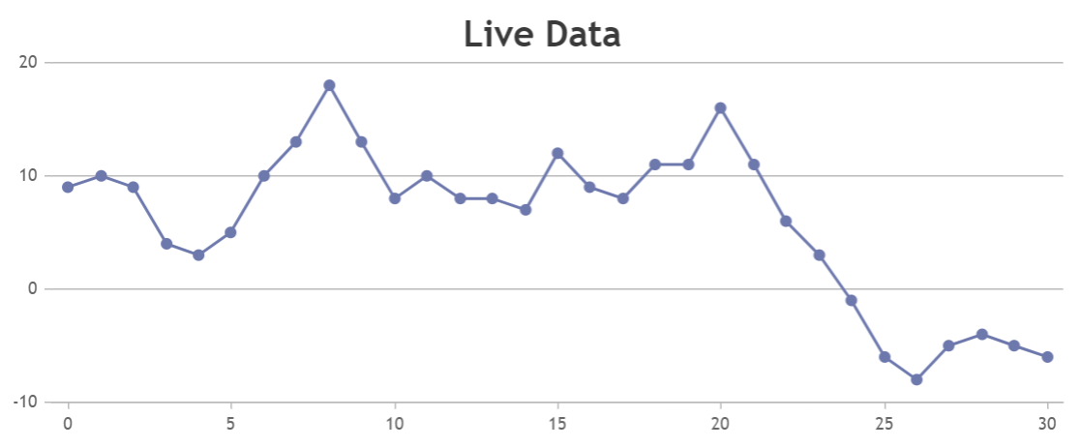
Introduction
Context: In today's digital age, organizations encounter a massive influx of streaming data from various sources like websites, social networks, and IoT devices. This surge in data provides both challenges and opportunities, necessitating the development of efficient methods to handle and utilize this continuous flow of information.
Challenge: Organizations must process and analyze streaming data in real time to make quick, informed decisions. Traditional data processing methods are often insufficient for the volume and speed of today's data streams, creating a demand for advanced real-time business intelligence solutions.
Importance of Visualization: Visualizing streaming data allows organizations to gain immediate insights into ongoing processes and events, enabling them to quickly identify patterns and anomalies. Effective visualization aids in determining whether automated actions, such as creating or modifying operational decisions, are warranted based on real-time data.
Objective: The project's primary goal is to develop a framework for dynamic, real-time data visualization using D3.js and a user control interface. This framework will transform raw streaming data into actionable insights, enhancing decision-making processes in critical sectors like finance, healthcare, and logistics.
Fig: Interactive line chart dashboard showing real-time data updates.
3

Slide 4
Background and Motivation
Background
Component-Based Design in Software Development
Modular units encapsulate related functionality.
Swap components for desired behavior or architecture.
Essential for data visualization packages.
Advantages of Component-Based Design
Reusability: Reuse well-designed components across projects, reducing development time and effort.
Versatility: Achieve high customization with low-level components for better representation of complex datasets.
Modularization: Separation of concerns for easier management and maintenance of codebase.
Interoperability: Export and integrate components into other tools, enhancing functionality and ensuring compatibility.
Motivation
Challenge in Visualization
High-level tools often limit customization.
Need for flexible, dynamic, and interactive visualizations for complex and dynamic datasets.
Objective
Utilize component-based design to create effective and interactive data visualizations.
Facilitate interpretation and analysis of complex datasets by leveraging reusability, versatility, modularization, and interoperability.
4

Slide 5
Literature Review
Key Topics:
Real-Time Visualization of Stream-Based Monitoring Data
Focus: Frameworks and methodologies for visualizing real-time data streams.
Reference: Mohedano-Munoz et al. (2022)
Findings: This paper explores the technical aspects of real-time visualization, emphasizing solutions for handling high-velocity data streams and presenting actionable insights.
Streaming Data Visualization Frameworks for Decision-Making Support in Intensive Care Units (ICUs)
Focus 1: Exploration of frameworks that facilitate streaming data visualization.
Focus: Analysis of visualization tools that aid decision-making in critical environments.
Reference: Baumeister et al. (2022)
Findings: Discusses a framework designed to support decision-making in intensive care units (ICUs), focusing on how effective visualization can improve clinical decision-making through real-time data integration.
Findings: Highlights how visualization frameworks can enhance decision-making by integrating real-time data into actionable insights, improving response times and accuracy in high-pressure scenarios.
5

Slide 6
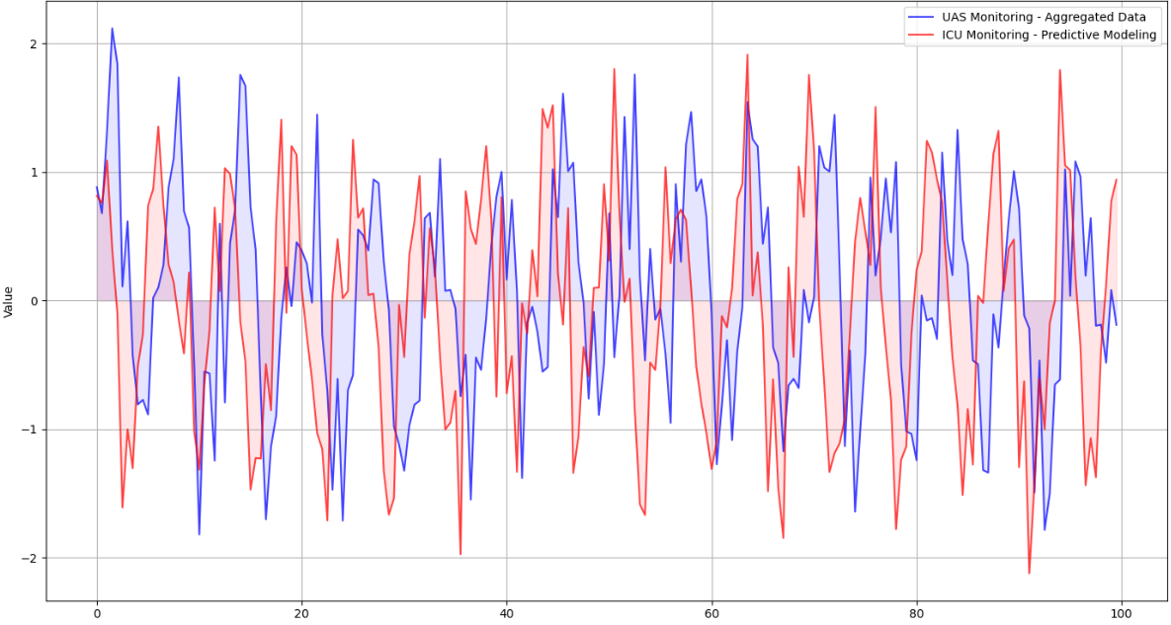
Literature Review
Relevant Studies:
Summary of Major Findings:
Mohedano-Munoz et al. (2022): Provides insights into real-time data visualization techniques, addressing challenges such as latency and data integration for effective monitoring.
Baumeister et al. (2022): Examines a streaming data visualization framework tailored for ICUs, showing how it supports critical decision-making by improving data accessibility and interpretability.
Influence on Decision-Making Processes:
The studies emphasize the critical role of advanced visualization techniques in real-time data handling and decision-making, particularly in high-stakes environments like ICUs. Effective frameworks not only enhance data presentation but also facilitate timely and informed decisions
Fig: Real-Time Data Analysis and Visualization of 'UAS Monitoring - Aggregated Data' and 'ICU Monitoring - Predictive Modeling
5

Slide 7
Methodology
Foundational Principles:
Modularity: Application composed of distinct, independent components for data ingestion, processing, visualization, and user interaction.
Reusability: Components are designed for reuse across the application, reducing redundant code and ensuring consistency.
Ease of Integration: Component-based approach allows for seamless incorporation of new features without disrupting the system.
Component-Based Approach:
Visualization Components: Utilizes D3.js for dynamic, interactive data visualizations.
Generator Components: Convert data sets into geometric descriptions for visualization.
Layout Components: Organize data into structures compatible with visualization components.
Key Architectural Features:
Modularity: Independent components optimized and extended individually.
Reusability: Ensures easier maintenance and scalability by reusing components.
Flexibility: High-level declarative tools built on top of D3.js for seamless integration.
6

Slide 8
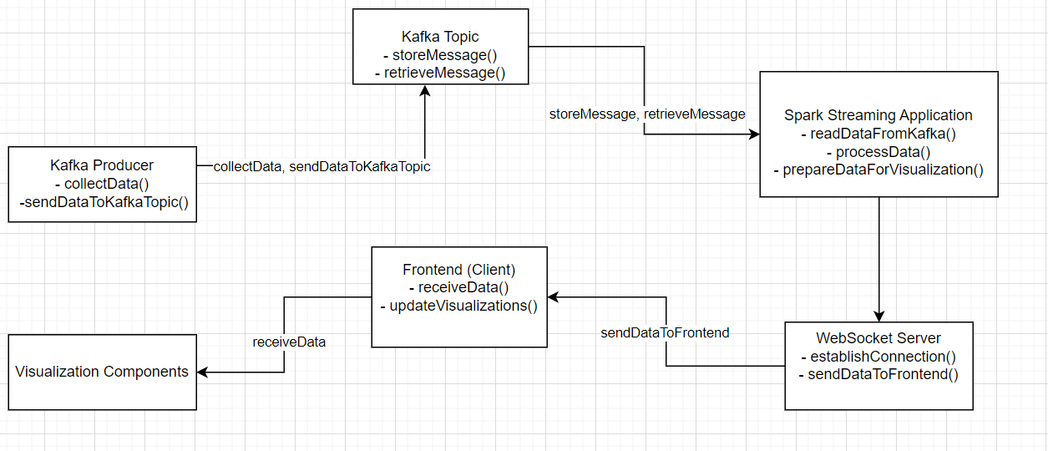
Architectural Structure
Robust Component Architecture:
Designed for Real-Time Data Streaming Visualization and Control
Three Primary Areas:
Data Components
Visual Components
Dynamic Control
Data Components:
Kafka Producer:
Gathers data from various sources.
Sends data to Kafka topics
Spark Streaming Application:
Processes data from Kafka.
Prepares data for visualization.
WebSocket Server:
Transmits processed data to frontend.
Ensures real-time updates for visualizations.
Fig: Data Flow and Component Diagram
6

Slide 9
Data Collection and Processing
Data and Massive Data Transmission
System processes massive real-time data from various sources.
System processes massive real-time data from various sources.
Components
Kafka Producer: Packages data into messages for Kafka topics.
Advantage: Fault tolerance and scalability.
Spark Streaming Application: Reads and processes data from Kafka topics.
Advantage: Large-scale data processing with low latency.
Polygon.io: Real-time streaming data.
Advantage: Access to reliable, real-time financial market data
WebSocket Server: Transmits processed data to frontend.
Advantage: Real-time updates for dynamic user experience.
7

Slide 10
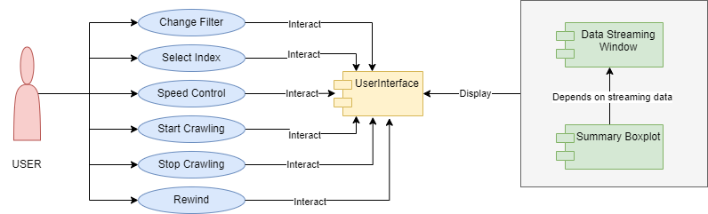
Visual Components
Dynamic and Interactive Real-Time Data View:
Immediate Data Representation: Provides users with an immediate visual representation of incoming data.
User Engagement: Enhances user engagement by allowing real-time interaction with data.
Data Stream Window (Crawler Component):
Function: Displays continuous data flow, capable of handling large volumes.
Features: Versatile and reusable, ensuring consistent performance across different datasets.
Summary Boxplot:
Function: Dynamically summarizes the visible dataset
Features: Updates in real-time, offering quick statistical insights.
Fig: Data Flow and Component Diagram
8

Slide 11
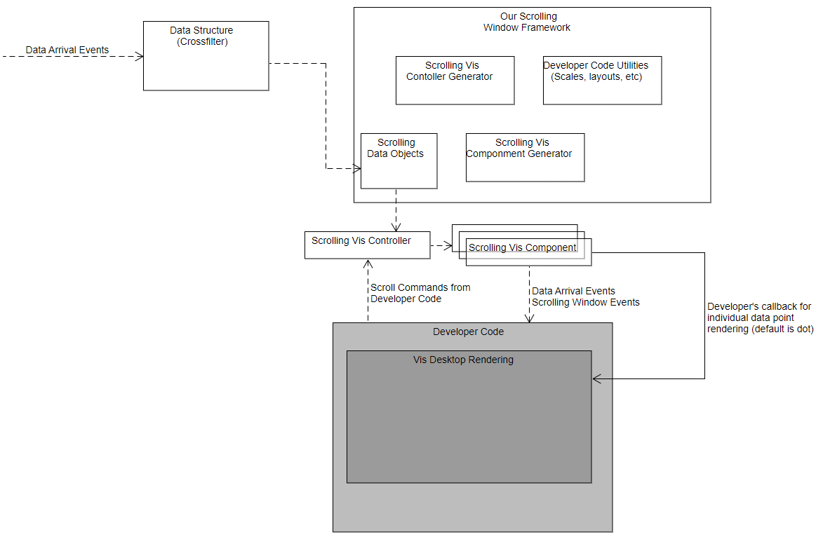
Control Interface
Dynamic and Interactive Real-Time Data View:
Scrolling Window Framework:
Function: Manages incoming data points using Crossfilter.
Benefit: Ensures smooth handling of real-time data streams.
Scrolling Vis Controller Generator:
Function: Dynamically generates controllers for scrolling behavior.
Benefit: Provides flexibility and control over data presentation.
Scrolling Vis Component Generator:
Function: Dynamically generates visual components for scrolling visualization.
Benefit: Allows for easy customization and adaptation to various data visualization needs.
Developer Flexibility:
Custom Rendering Callbacks:
Function: Allows for personalized data point rendering.
Benefit: Enhances user interface and facilitates quick insights.
Fig: Frontend Architectural Diagram
9

Slide 12
Results and Findings
Enhanced Data Stability Monitoring:
Real-Time Consistency: Continuously monitors and visualizes data across multiple threadlines, updating the Boxplot and Data Stream Window in real-time.
Continuous Updates: Provides an ongoing view of data trends and stability, helping to identify inconsistencies promptly.
Interactive Visualization for Anomaly Detection:
Real-Time Interaction: Users can interact with the Data Stream Window and Boxplot, allowing for dynamic analysis and exploration of the data.
Quick Anomaly Detection: Enables fast identification of anomalies and outliers through color-coded data points and interactive features.
Effective Real-Time Feedback:
Color-Coded Visualization: Data points are color-coded for clarity, with interactive features providing detailed insights.
Immediate Performance Feedback: Delivers real-time feedback on machine performance, supporting quick assessment and troubleshooting.
10

Slide 13
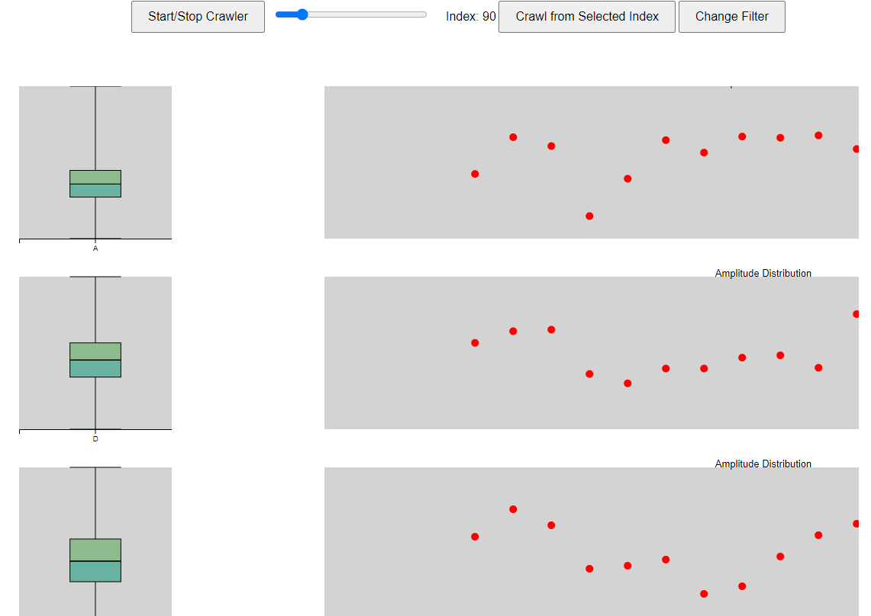
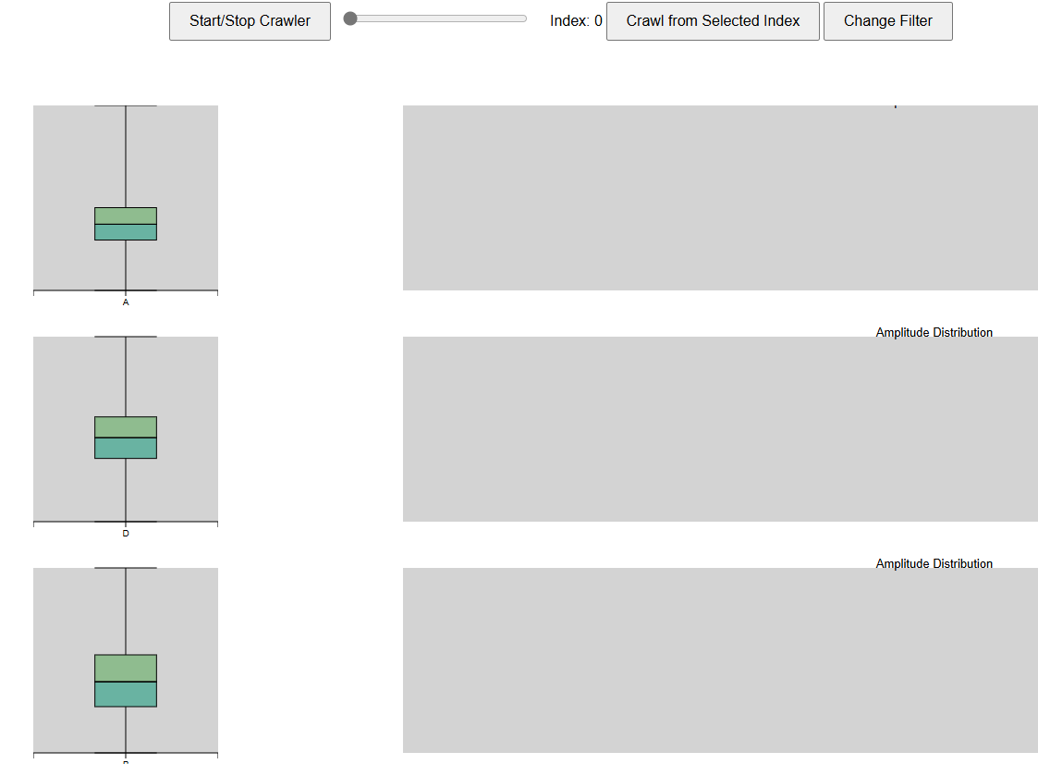
Results and Findings
Image: Include the two images provided in my report showing before and after data points flow across the crawler.
Fig: Before the data points flow across the crawler
Fig: Data points flow across the crawler and the boxplot changes dynamically
10

Slide 14
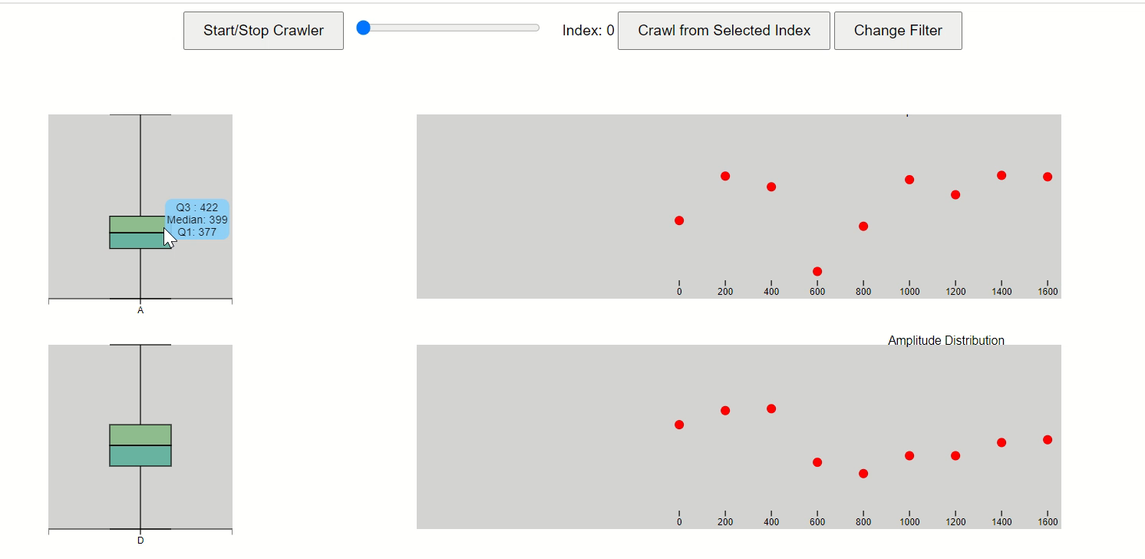
Results and Findings
Recording: Recording of the Data Streaming
10

Slide 15
Challenges and Solutions
Real-Time Data Monitoring:
Challenge: Managing high-throughput data without performance degradation.
Solution: Optimized data handling techniques and implemented efficient processing methods to maintain performance.
Visualization Complexity:
Challenge: Ensuring the system is complex enough to provide detailed insights while remaining user-friendly.
Solution: Designed with a focus on simplicity and clarity, incorporating interactive elements to enhance usability without overwhelming the user.
Consistency Measurement:
Challenge: Creating a reliable model to measure data consistency in real-time.
Solution: Integrated the Boxplot and Data Stream Window, providing a robust visualization approach to effectively monitor and measure data consistency.
11

Slide 16
Future Work
Advanced Analytical Features:
Integrate predictive models and automated anomaly detection.
Enhance proactive data analysis and problem anticipation.
Enhanced Customization:
Offer adjustable visualization parameters and customizable data filters.
Allow users to personalize alerts and thresholds.
Integration and Scalability:
Focus on integrating with ERP systems and data lakes
Optimize for handling large data volumes and distributed processing.
User Feedback Incorporation:
Gather and analyze user feedback for continuous improvement.
Regular updates based on user suggestions and experiences.
12

Slide 17
Conclusion
The Crawler Component has proven to be highly effective in addressing the challenges encountered by engineers. By providing a dynamic display of real-time data streams and an enhanced visualization of anomalies, the tool has significantly improved the monitoring and management of production lines. The integration of the Data Stream Window and Boxplot ensures that engineers receive immediate feedback and can interact with data in real time, leading to quicker identification of issues and more informed decision-making.
Overall, the implementation of the Crawler Component has brought about significant improvements in real-time data visualization and anomaly detection. The tool's design effectively balances functionality and usability, ensuring that users can easily interpret and act on the data presented.
13

Slide 18

18

